Slide 1
3D Printing
3D Printing
Barry H Ginsberg, MD, PhD

Slide 2
3D Printing
Printing in Plastic
Printing in Metal
Printing Other Materials

Slide 3
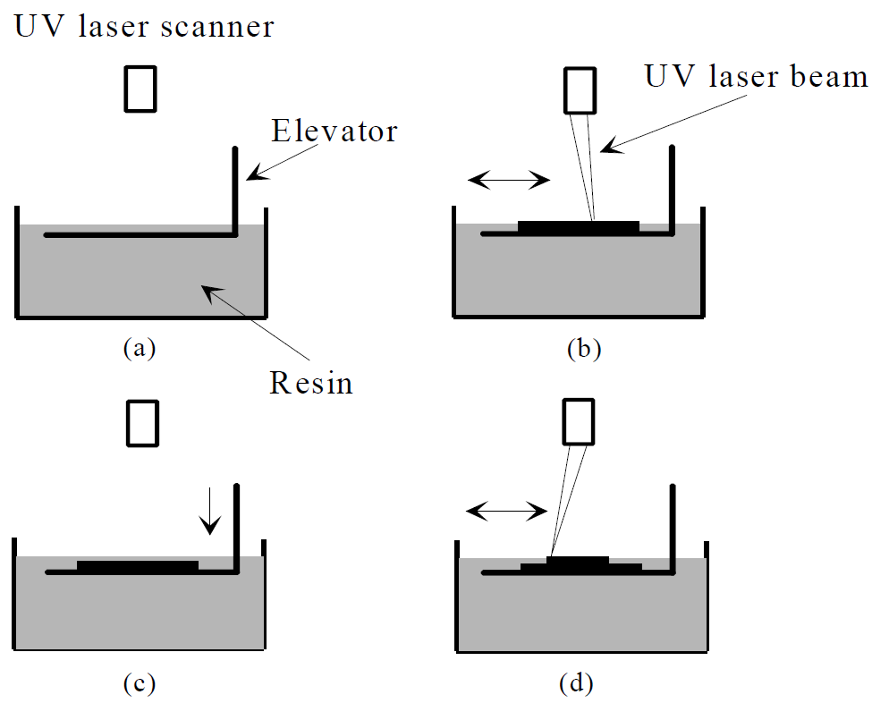
Printing in plastic
Stereolithography
First 3D printers, 1980’s
Use light-sensitive liquid polymer in Vat (dark)
Hardens with light
Platform/Elevator just below top of plastic
Write on with laser
Lower platform
Repeat

Slide 4
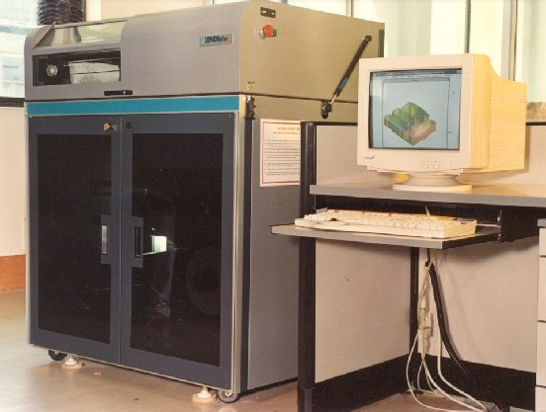
Printing in plastic
Stereolithography
Machines big and expensive ($250K)
Polymer $800/gal (~$100/kg)
Only limit on printing is that layers need to be attached
Generally only used in industry

Slide 5
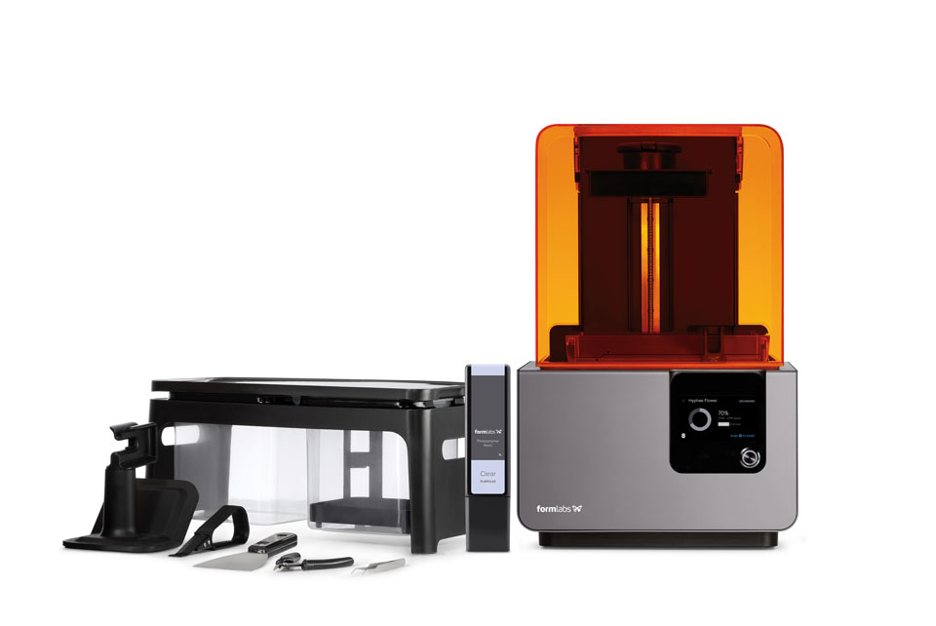
Desktop 3D SLA
Desktop 3D printer
~$3500
Resin $150 vat

Slide 6
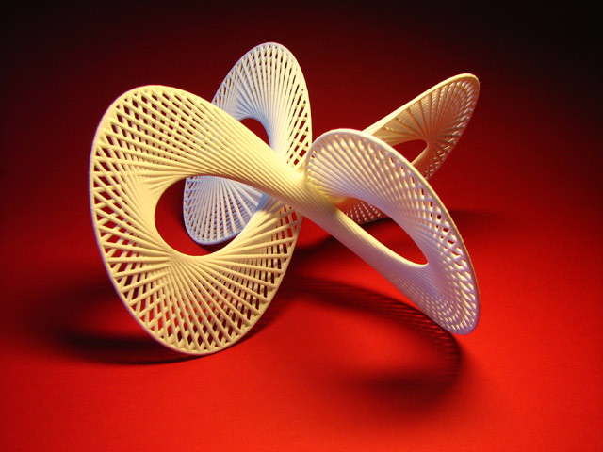
Printing in plastic
Stereolithography
Early plastics were not robust, now better.
Models to: Show consumers Show management Test for function Test for ease of use

Slide 7
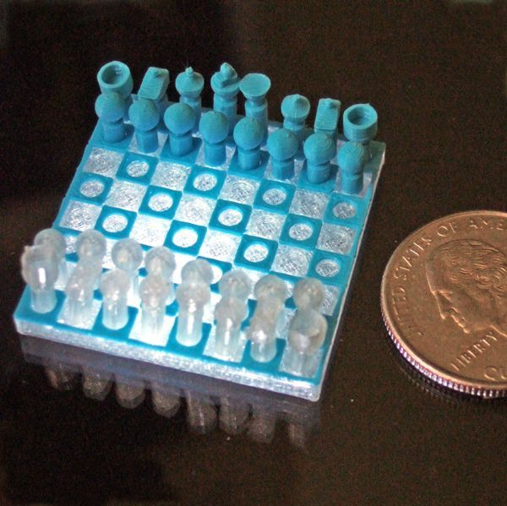
Software, Modeling and language
Need a CAD program, 123D Design
Create the object from primitives (cubes, rods, freehand, polylines)
Save the CAD file
Export as a STL file (STereolithography Language)

Slide 8
Software, Modeling and language
STL is a subset of G-code (used for all CAM)
Creates layers
The CAM program will read the STL file and adapt
Will add support if necessary

Slide 9
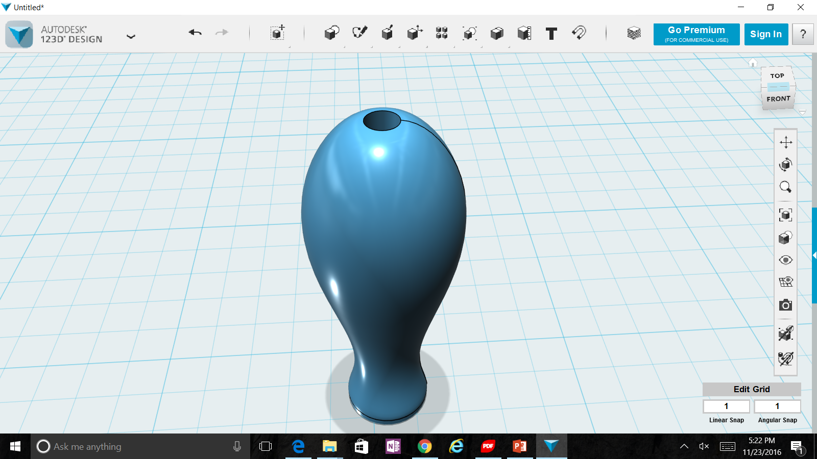
Software, Modeling and language

Slide 10
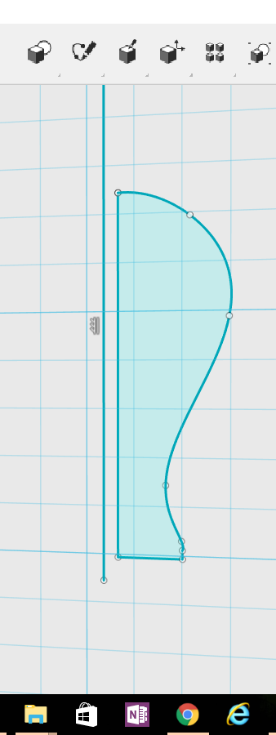
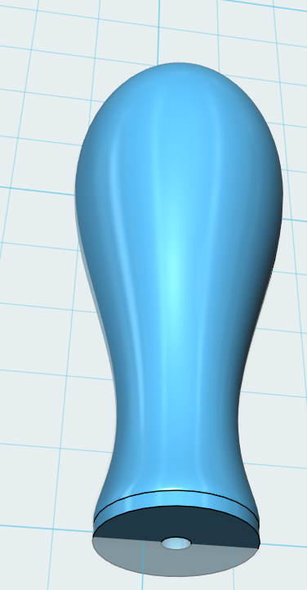
Software, Modeling and language

Slide 11
3D Extruder video (ces)

Slide 12
3D Extruders
Heat plastic filament to >200 C (>400 F)
Force through a nozzle to 0.4 mm (0.016 in)
Move back and forth like a plotter, laying down plastic
Raise head 0.2 mm and repeat laying down plastic

Slide 13
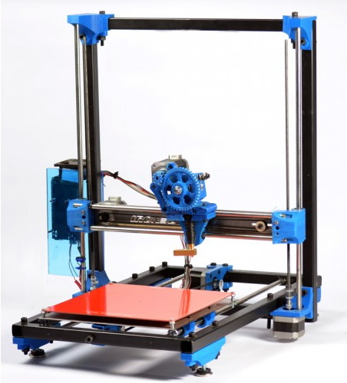
3D Extruders
Print head (x axis)
Elevator (z axis)
Plate (y axis)
Filament
Feeder

Slide 14
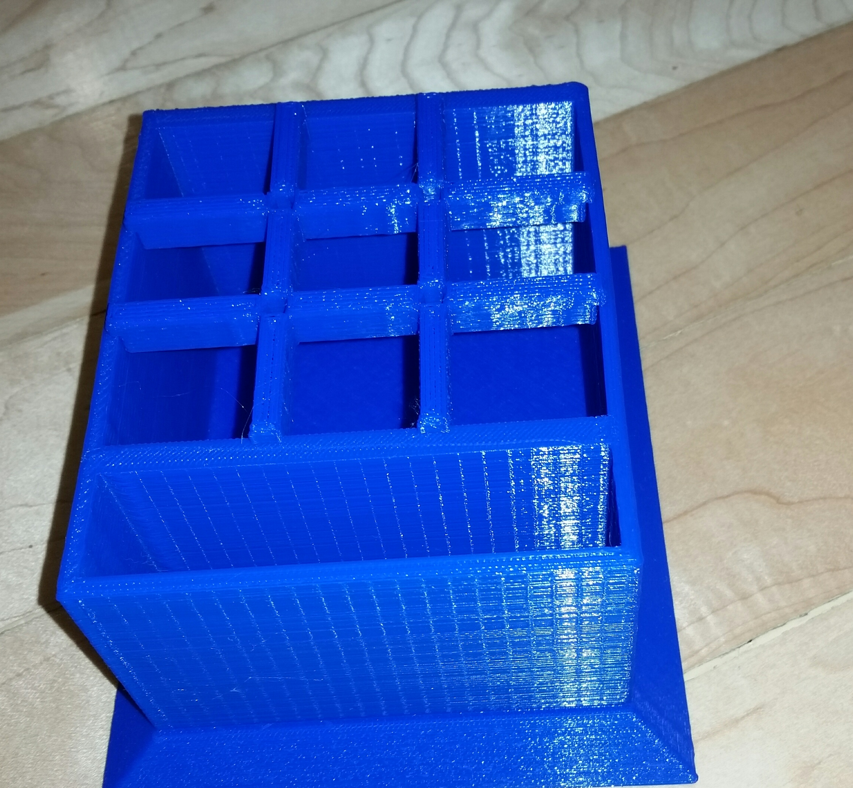
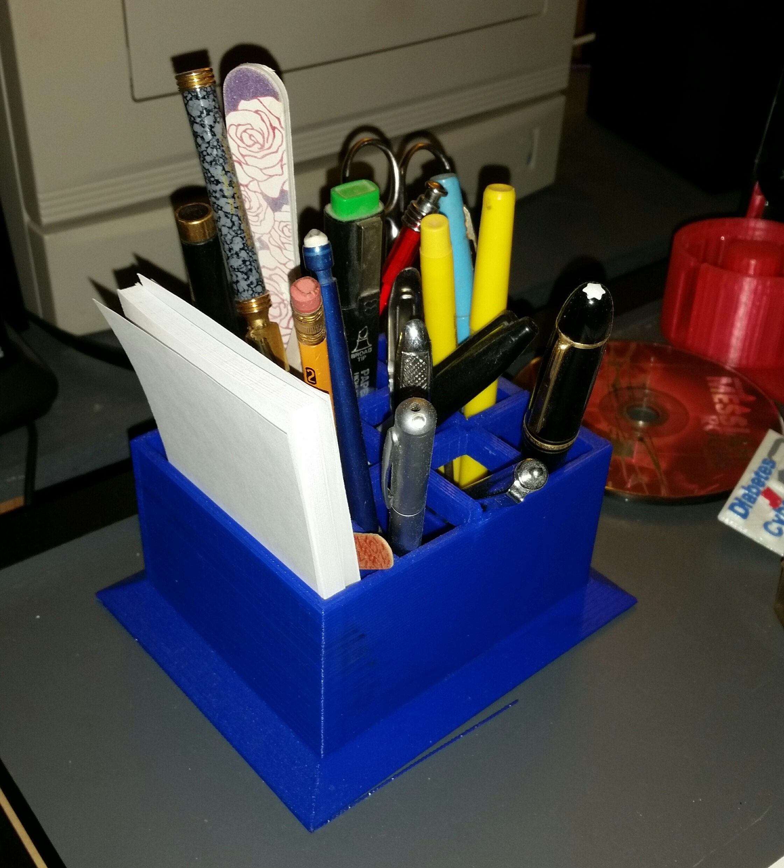
3D Extruders
Slow
Pencil holder about 4 hours
About 25 cents in plastic

Slide 15
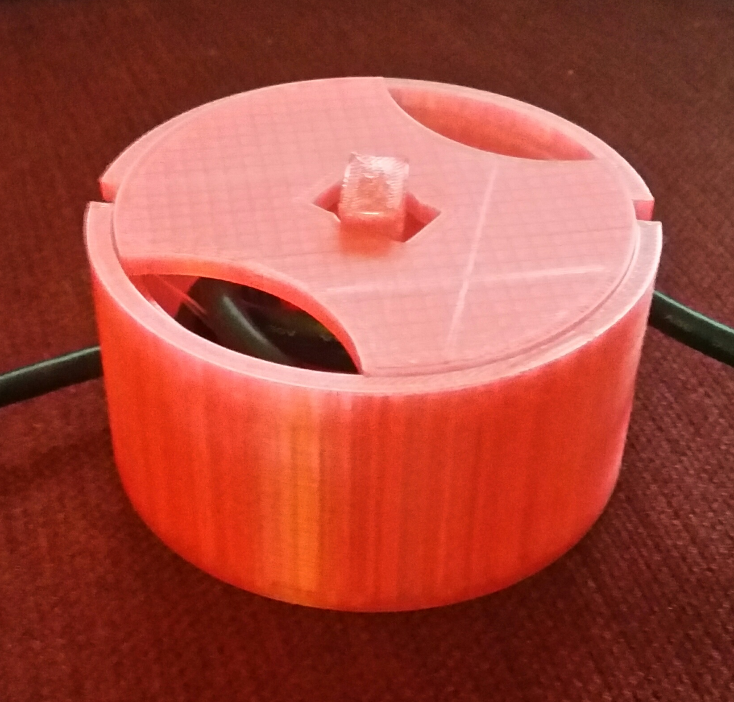
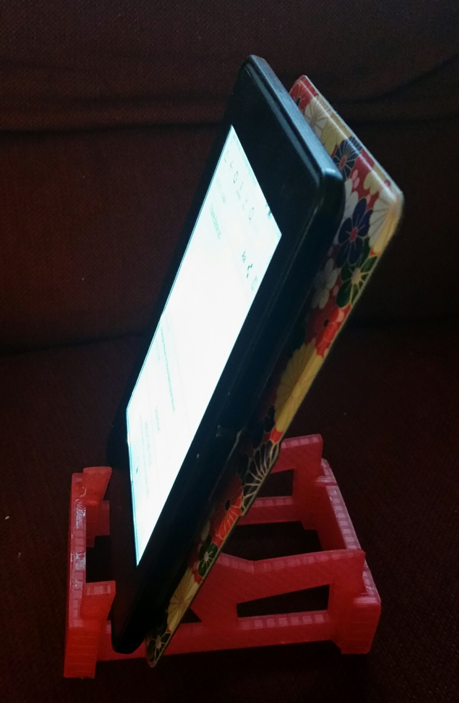
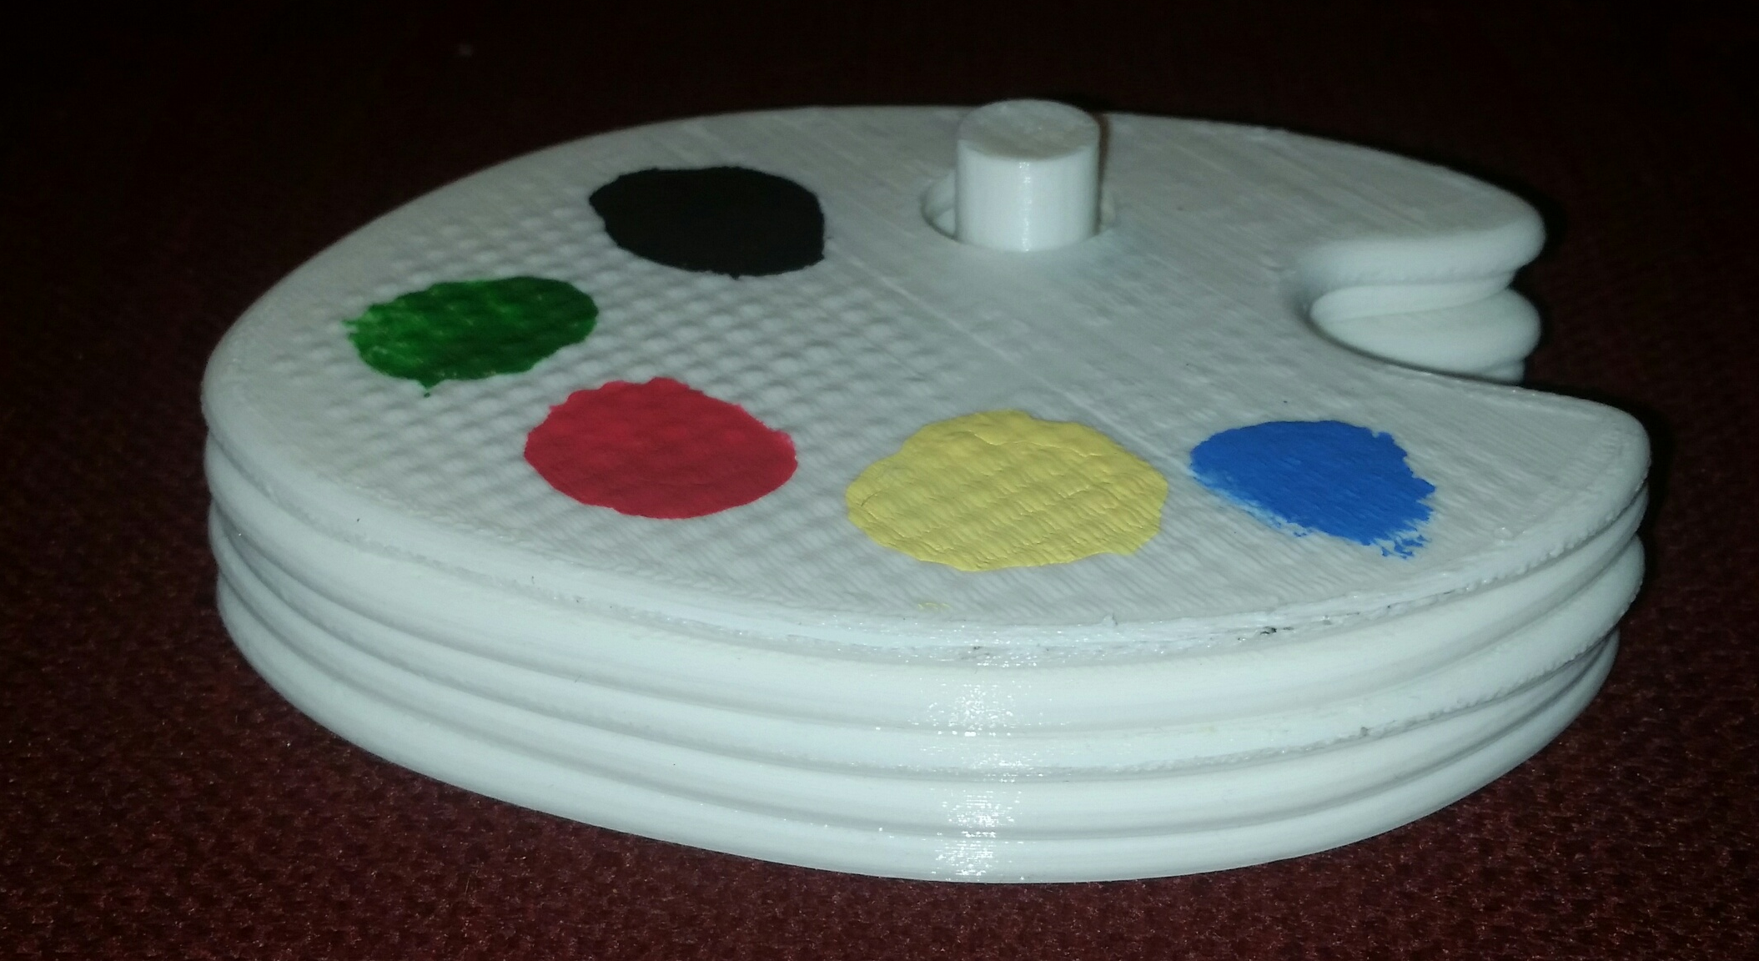
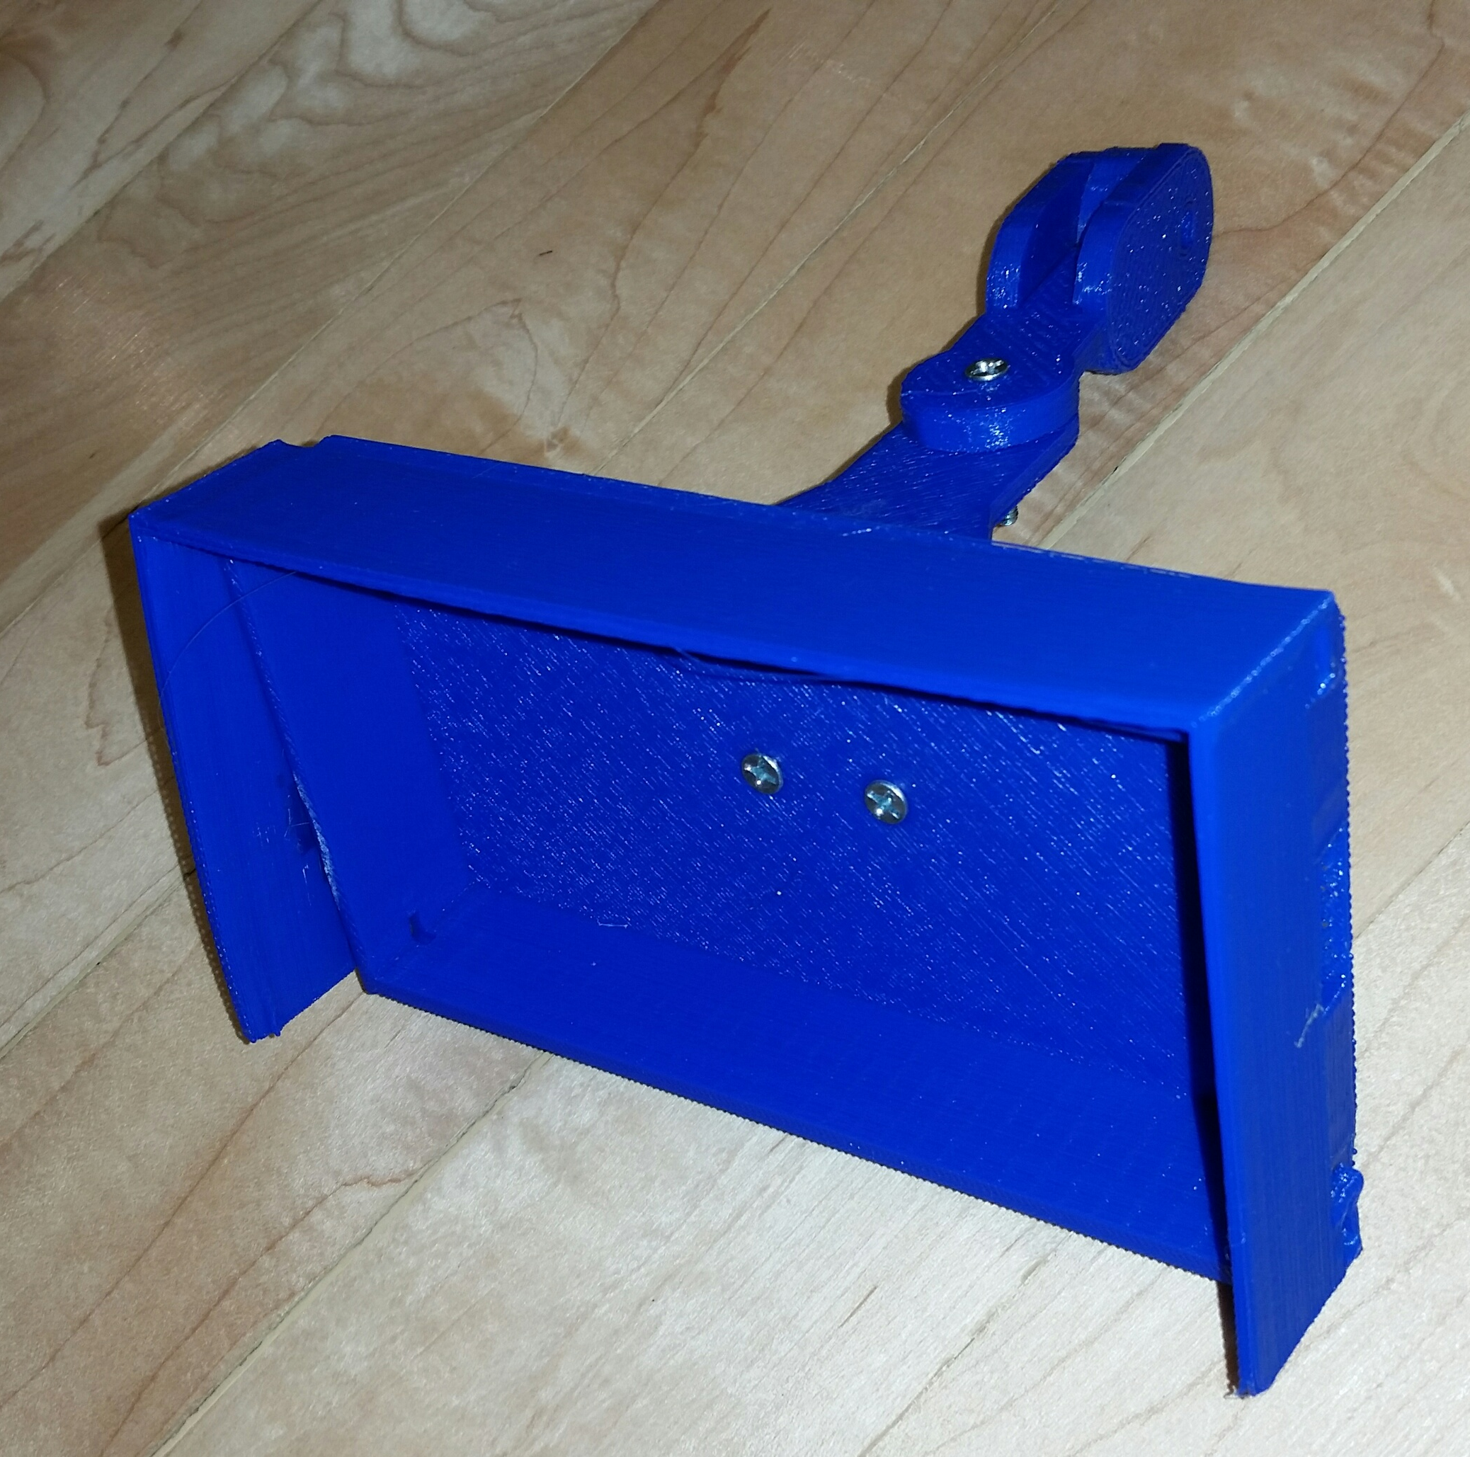
Some of my projects

Slide 16
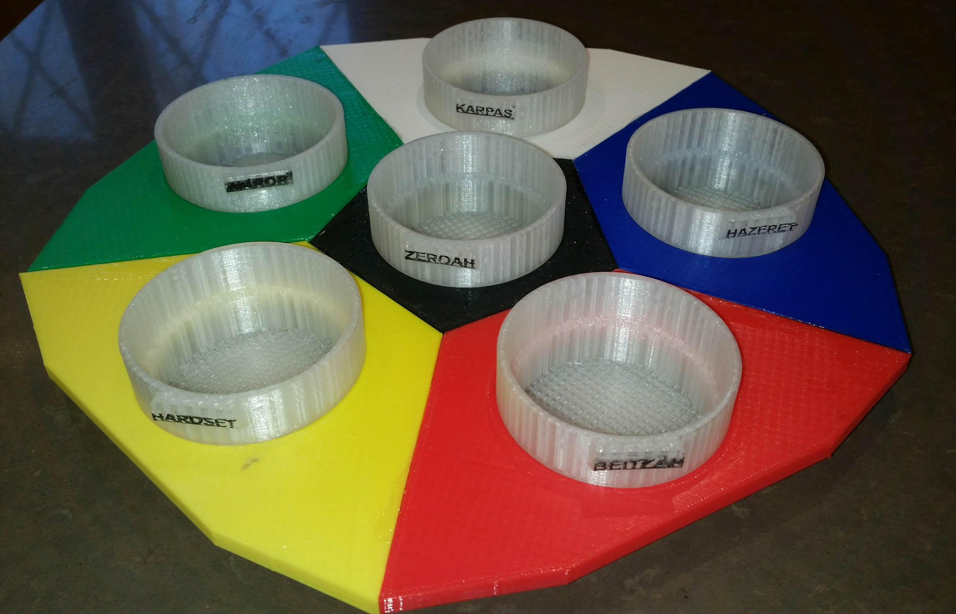
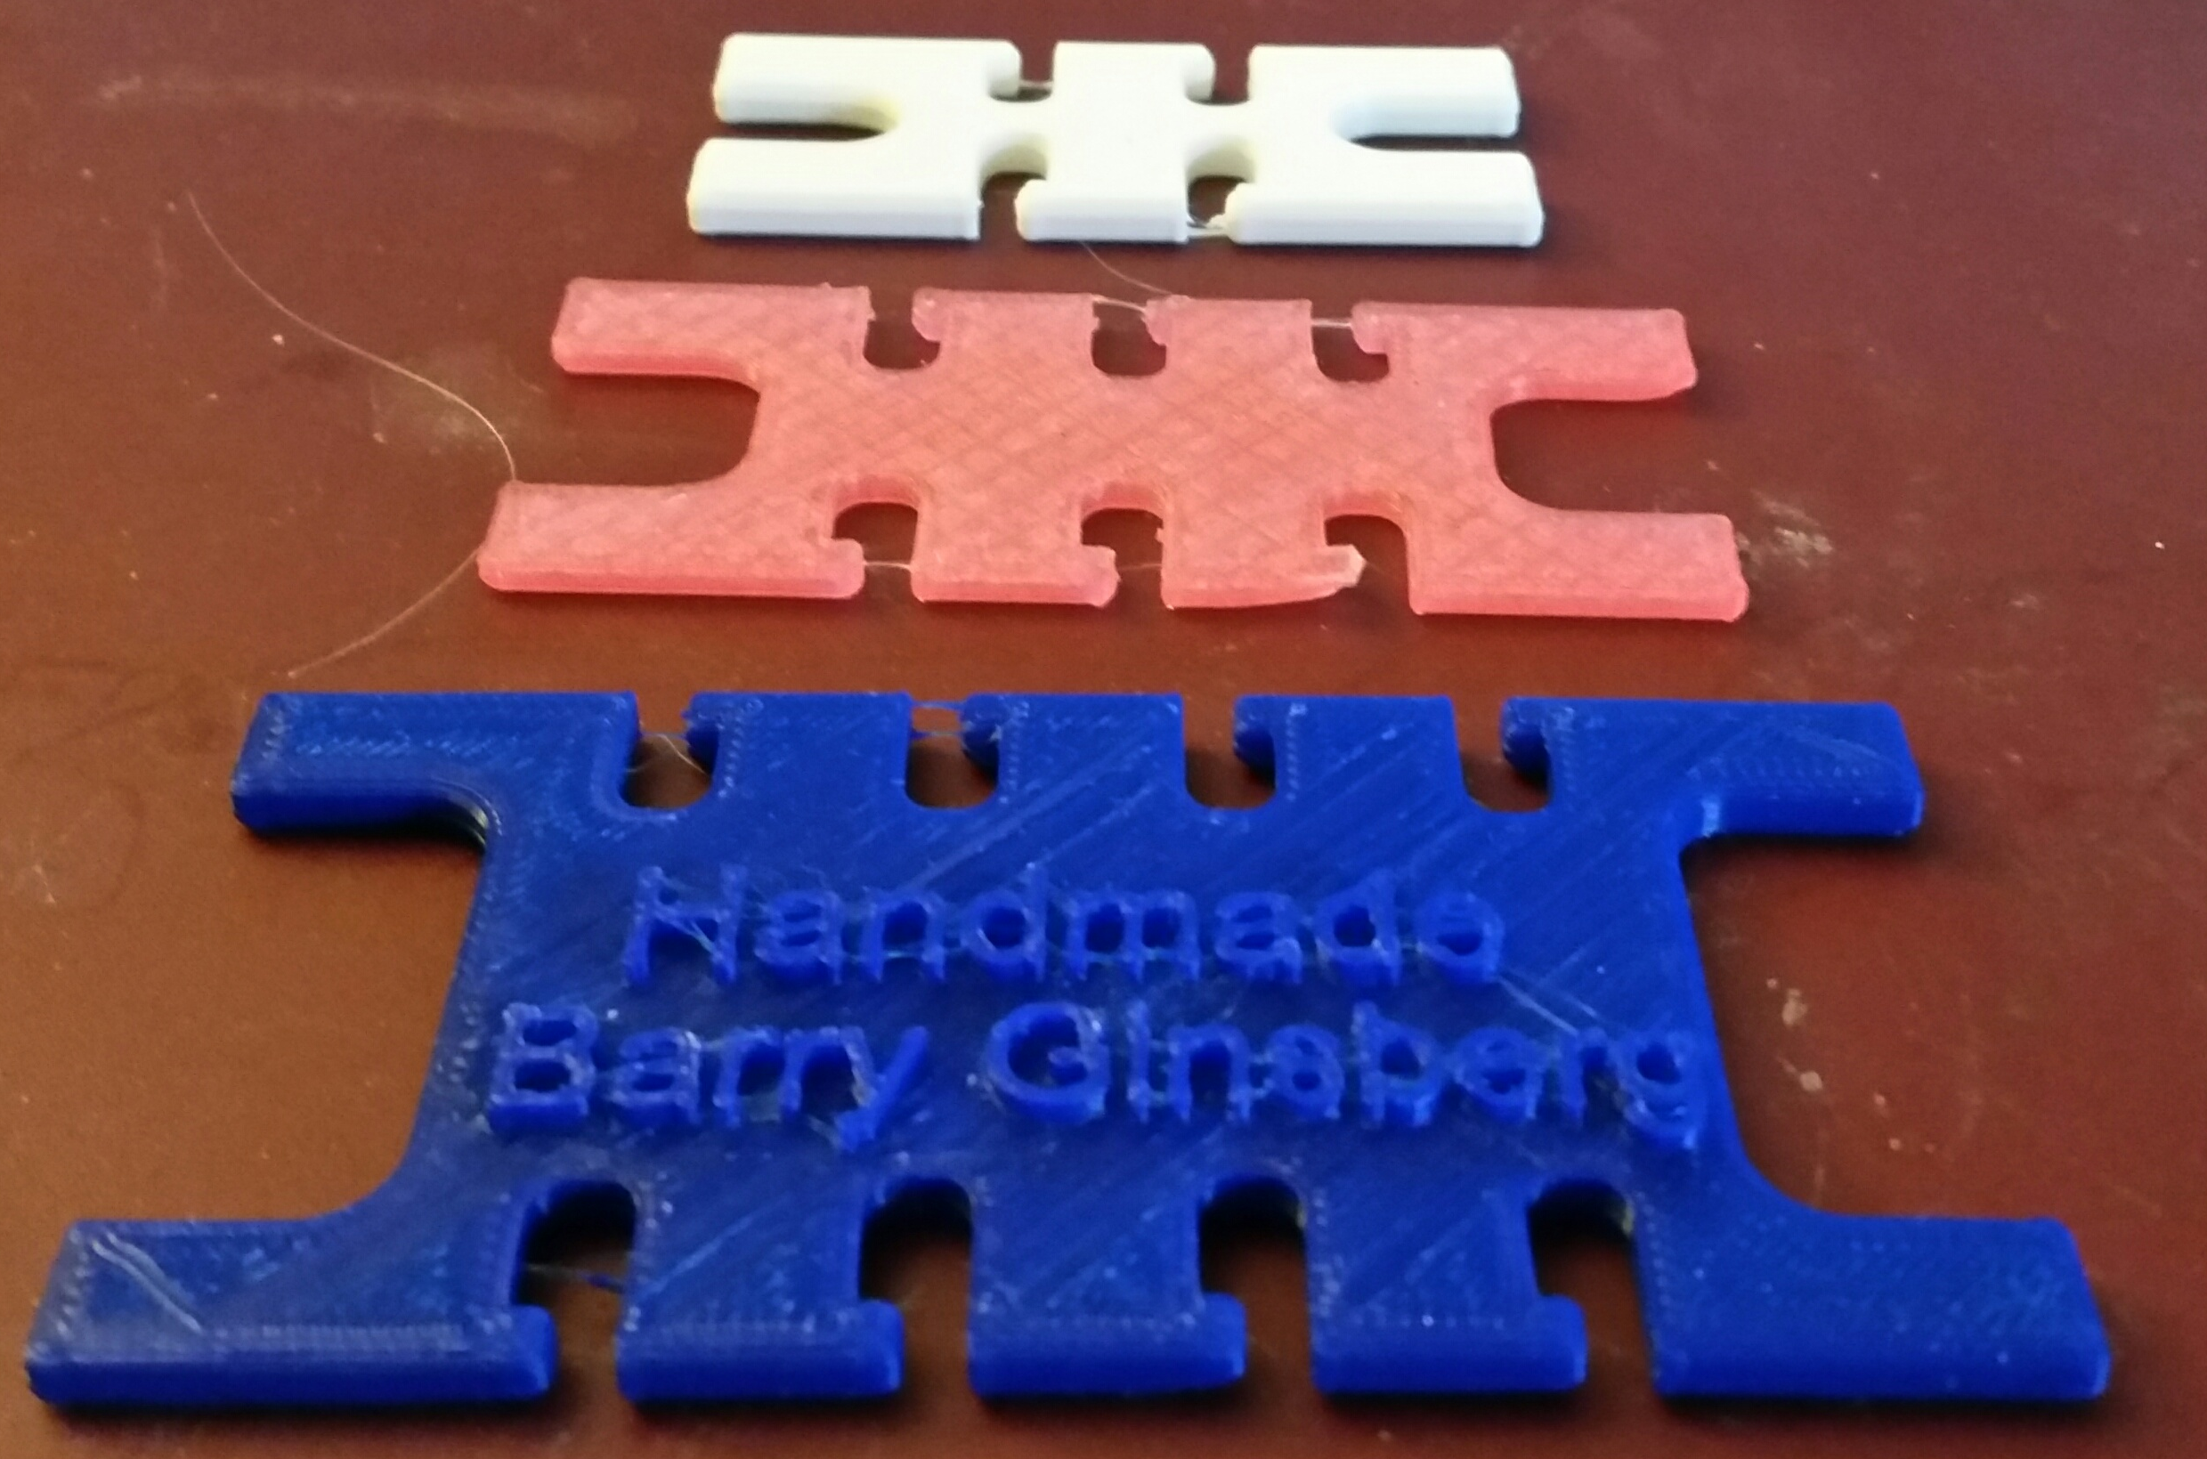
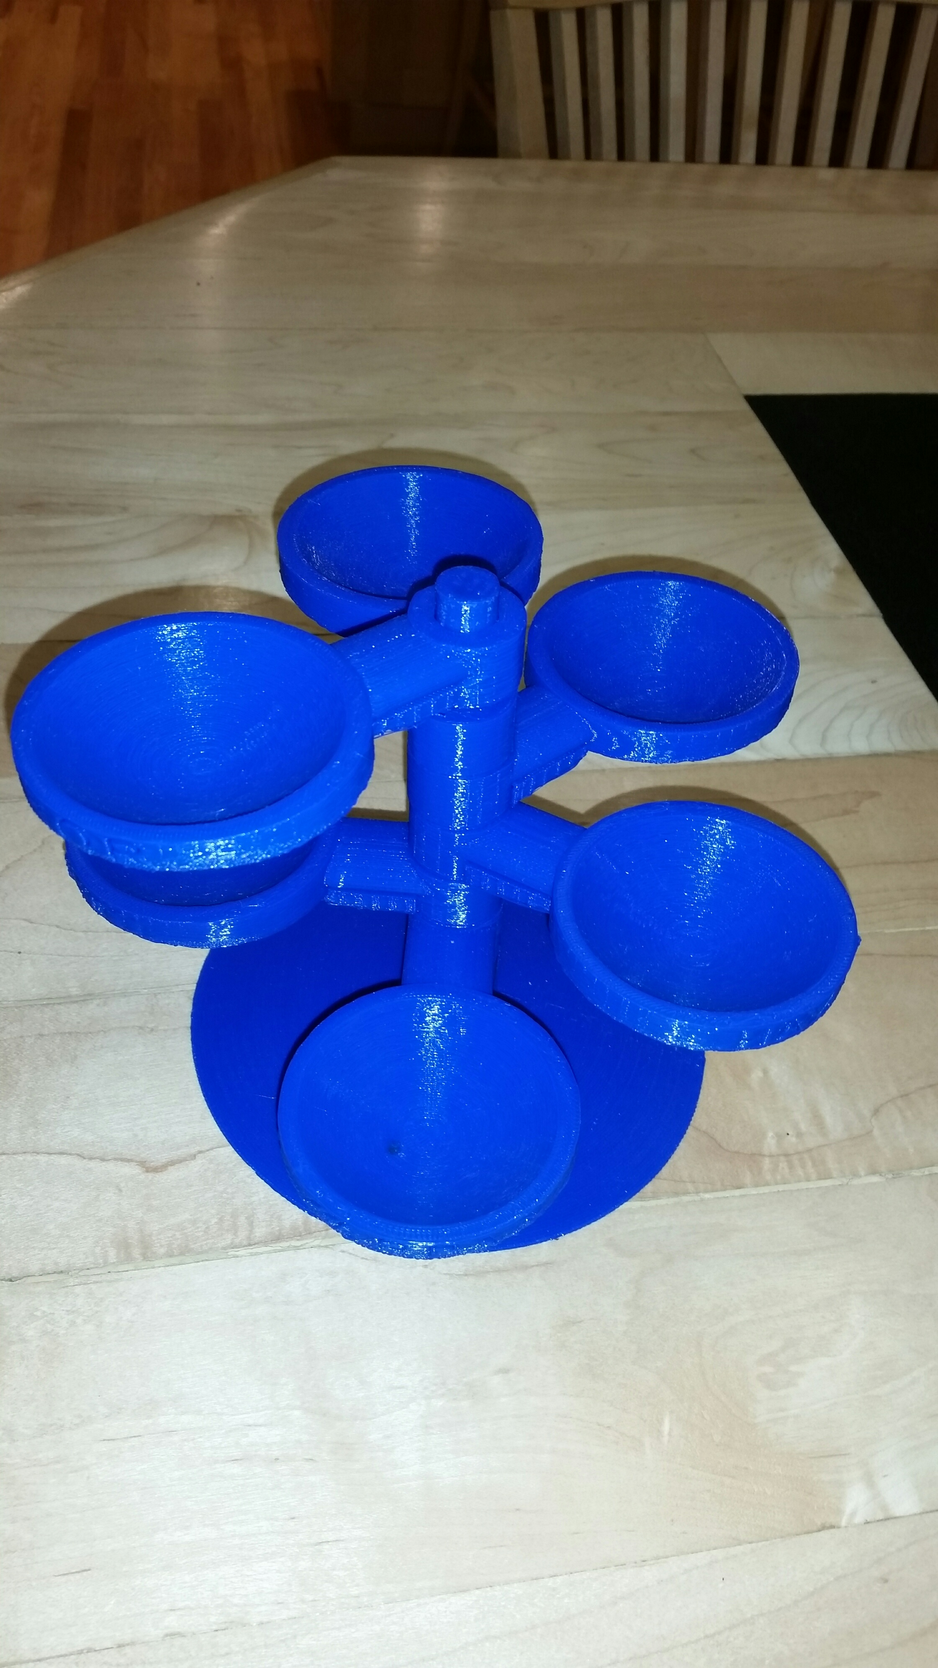
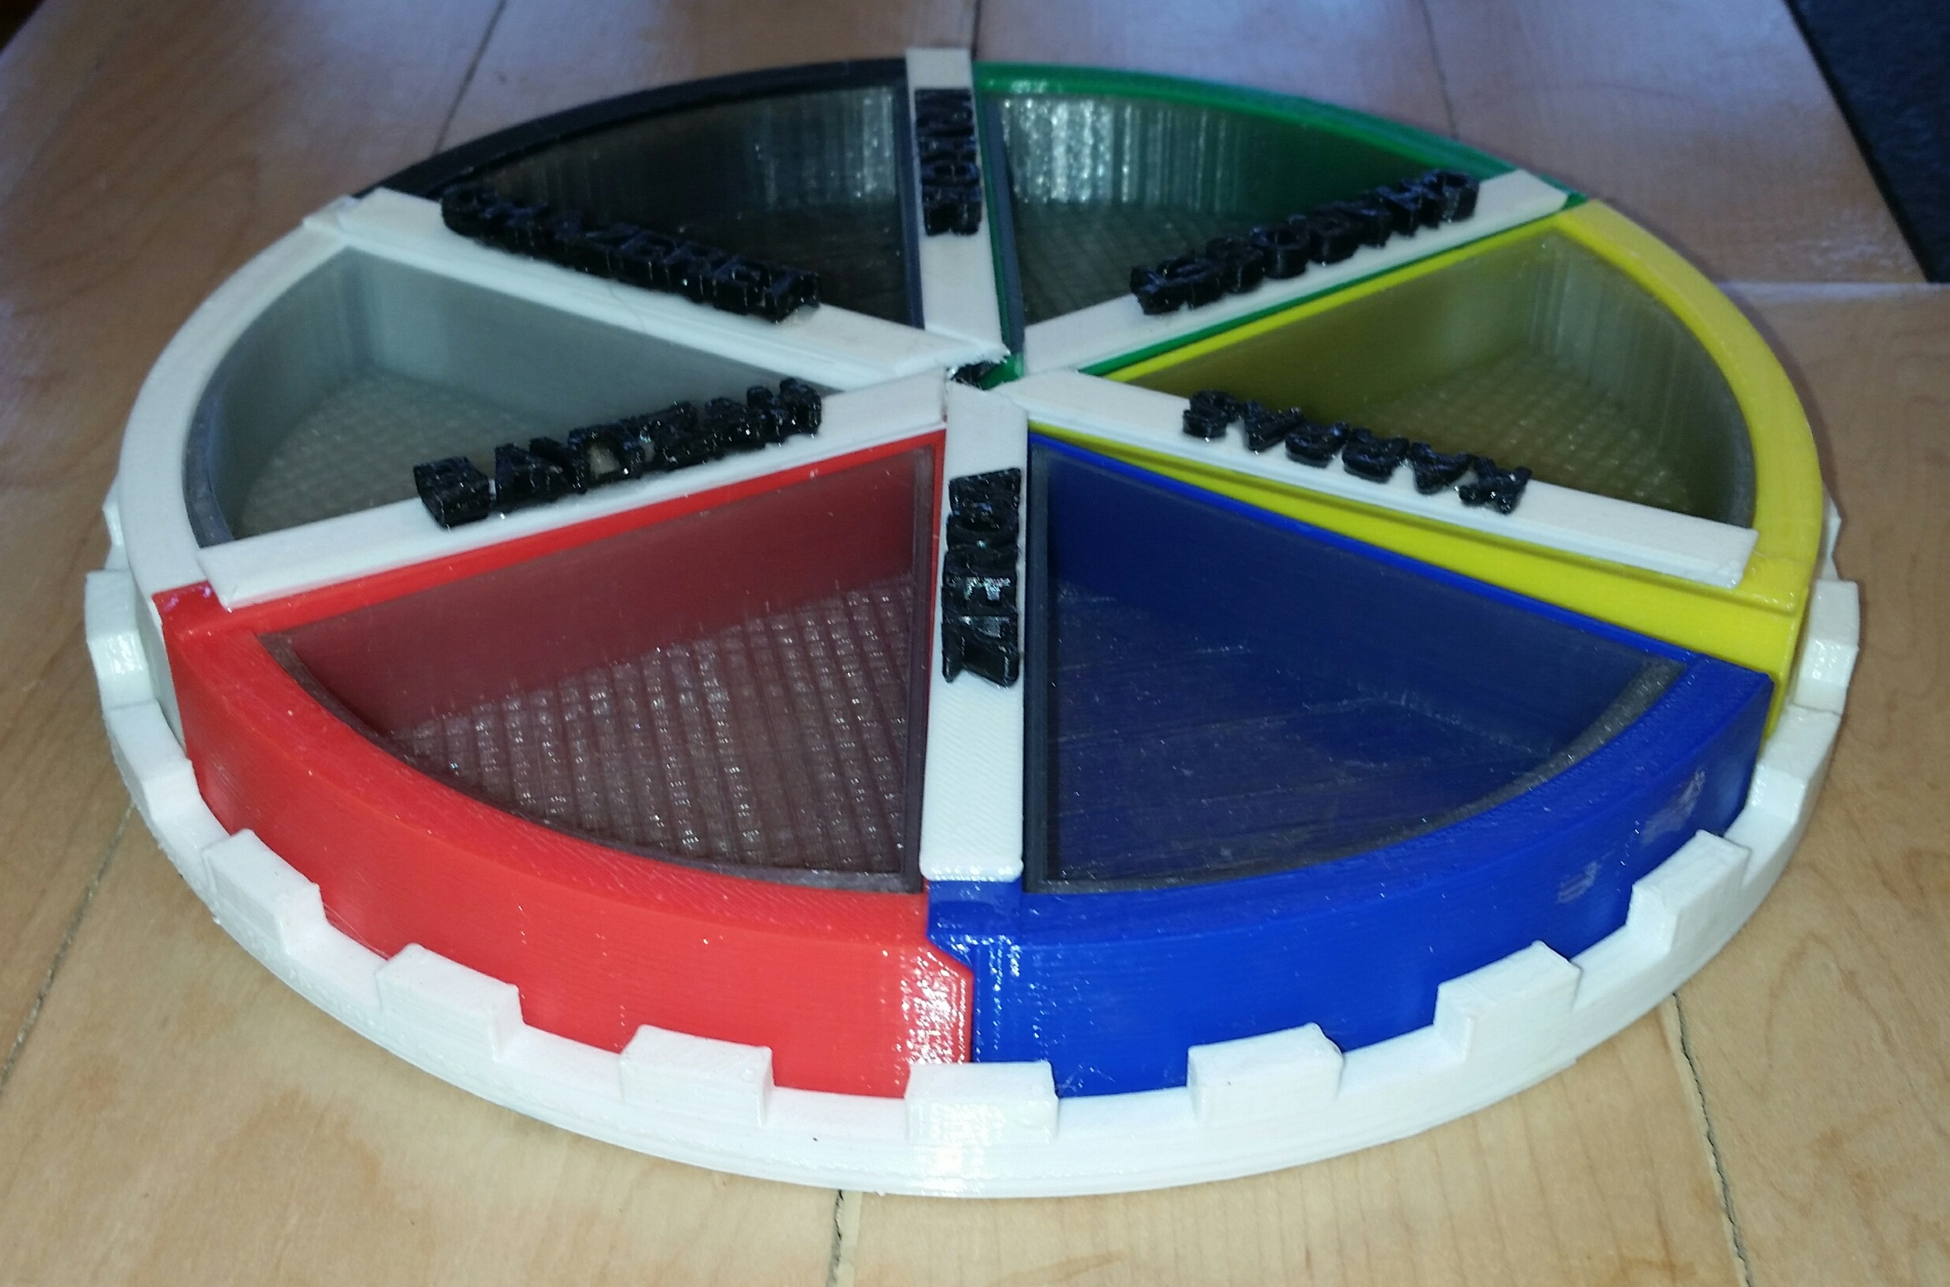
Some more of my Projects

Slide 17
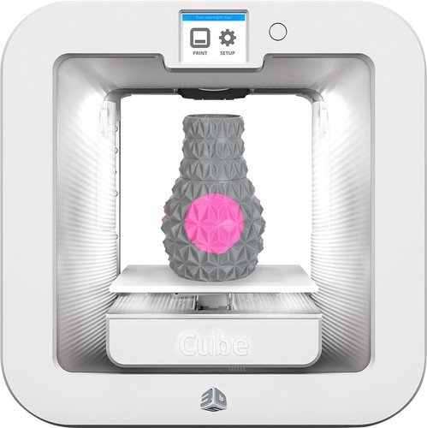
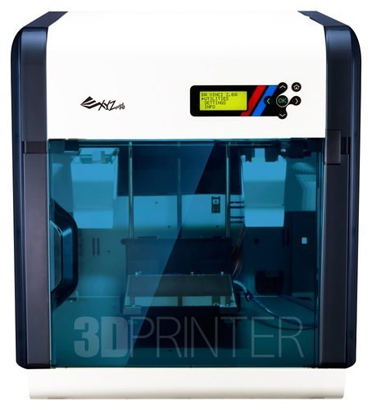
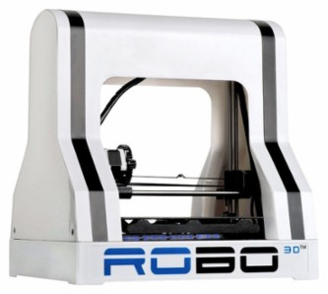
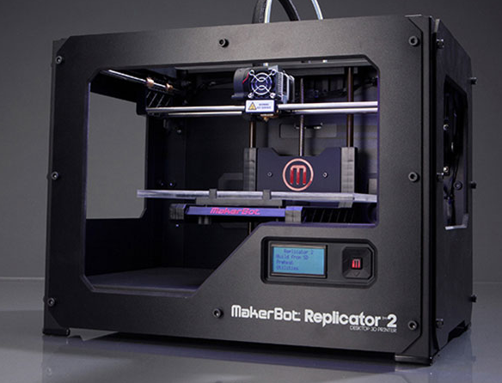
Buying a 3d printer
3D printers are not expensive ($500-2500). I paid $2500 for my first laser printer ($5000 in today’s dollars)
They don’t required too much computer power (although the CAD may)
But they require frequent repairs that you have to do yourself.
Thus, I think they are not ready for prime time, but hobbyists can have a lot of fun with them
$300
$500
$700
$2500

Slide 18
3D Printing in metal (Praxa)

Slide 19
3D Printing in metal
Sintering metal powder with laser (strong)
Gluing metal powder with print head (needs bronze infusion)
Melting metal powder with laser (very strong)
Metal extrusion (1000-2600 F). Metal powder, laser, base/hotend on gimbals
Metal extrusion, metal nanoparticles, laser, can produce unsupported

Slide 20
3D Printing in metal (beam)

Slide 21
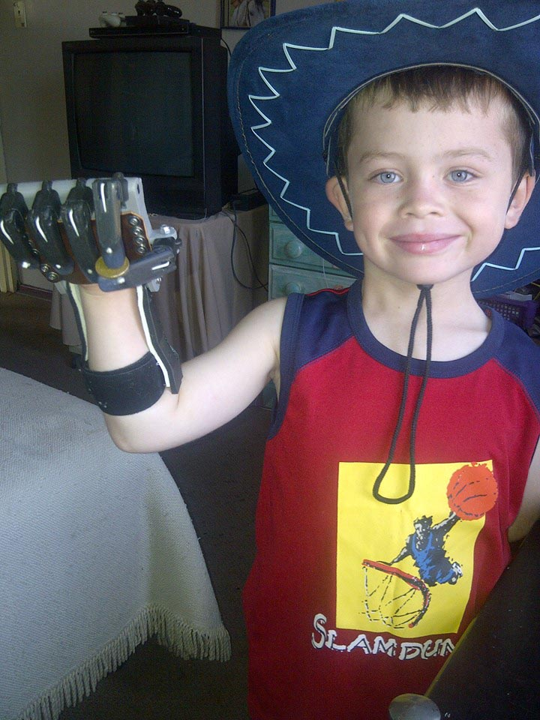
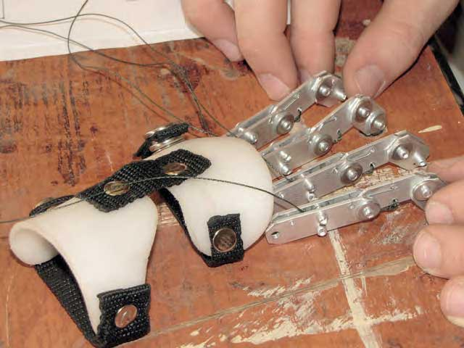
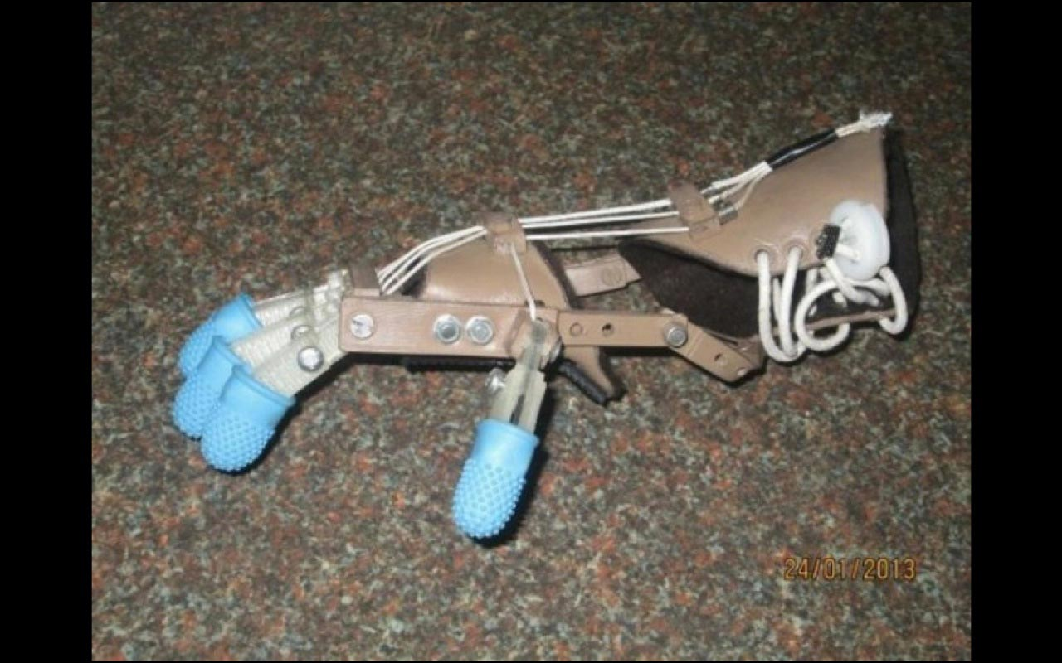
3D Printing, other
Printing a hand

Slide 22
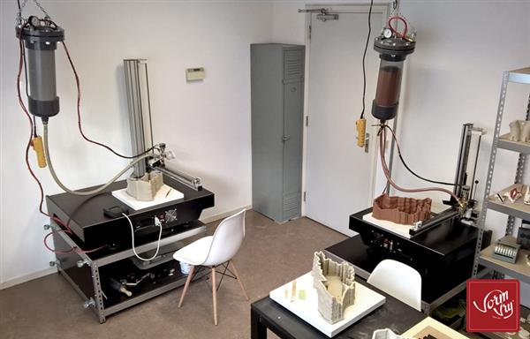
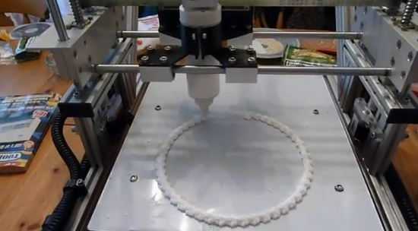
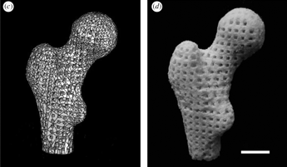
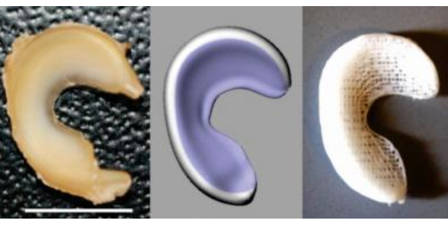
3D printing, other
Ceramics, using clay
Cake decorating Tissue scaffolding
Bone
Cartilage
Flexible
Blood vessels
Gut

Slide 23
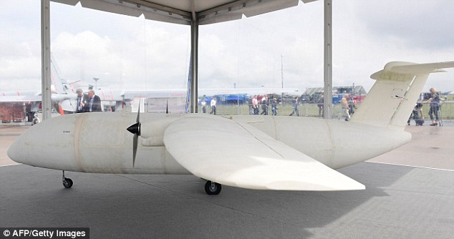
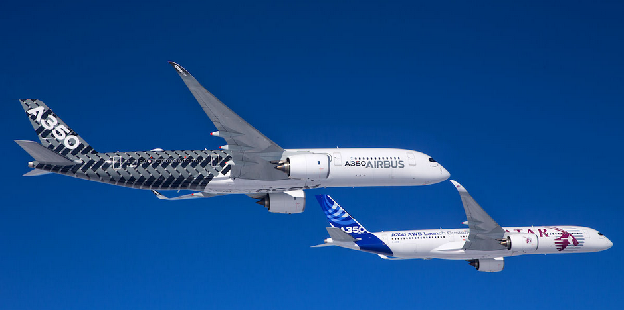
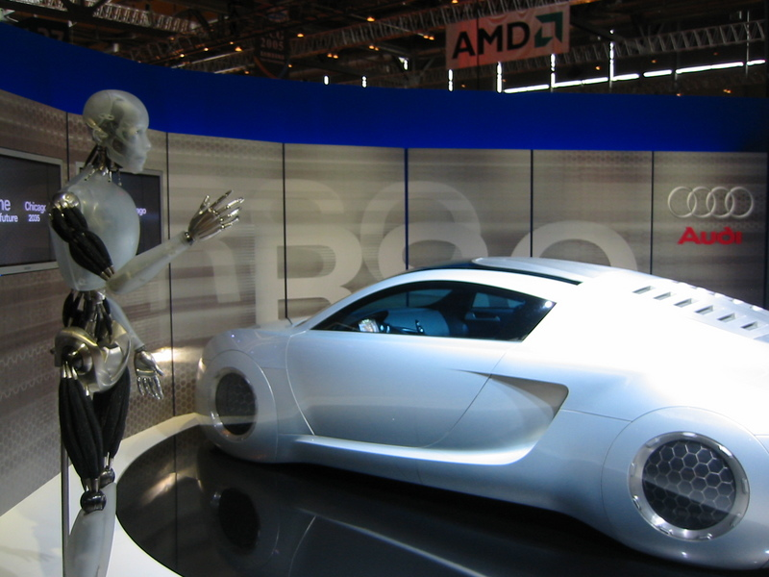
3d Printing, other
Airbus 350 has >1000 3D printed parts
3D printed structures

